Slide 1


PRESENTATION : PHASE 2 – VIVA VOCE
BATCH No.: BTC12
DOMAIN:ANDROID
PROJECT TITLE :ANDROID MALWARE DETECTION USING
CLOUD COMPUTING ALGORITHMS
S. No. | Register number | Name of the Student
1 | U19CS371 | G.V.SAI KRISHNA
2 | U19CS372 | G.SANDEEP
3 | U19CS346 | G.L.NARASIMHA REDDY
4 | U19CS375 | G.NIKIL RAO
GUIDED BY:MR.R.MUTHU VENKATAKRISHNAN

Slide 2
PROJECT PHASE 2 – VIVA VOCE
ABSTRACT :
The user has then the ability of selecting a specific permission, and a list of relevant sentences are extracted by the privacy policy and presented to them, along with an accurate description of the permission itself.
Such an interface allows the user to quickly evaluate the privacy-related risks of an Android application, by highlighting the relevant sections of the privacy policy and by providing useful information about sensible permissions.
We presented a novel approach to the analysis of privacy policies in the context of Android applications.
The tool we implemented greatly eases the process of understanding the privacy implications of installing third party apps and it has already been proven able to highlight worrisome instances of applications.

Slide 3
PROJECT PHASE 2 – VIVA VOCE
The tool is developed with expandability in mind, and further developments in the approach can easily be integrated in order to increase the reliability and effectiveness.
In addition, if your app handles personal or sensitive user data, please also refer to the additional requirements in the "Personal and Sensitive Information" section below.
These Google Play requirements are in addition to any requirements prescribed by applicable privacy or data protection laws.
We proposed, A user who wishes to install and use any third party app doesn’t understand the significance and meaning of the permissions requested by an application, and thereby simply grants all the permissions as a result of which harmful apps also get installed and perform their malicious activity behind the scene.

Slide 4
INTRODUCTION :
Mobile devices of various operating systems have exhibited a steep increase in the past decade, thus leading to an increase in the number and variety of applications that run on mobile devices.A closer look at the purpose of using mobile phones reveal that they are mostly used for web browsing, social networking, and online banking. In addition, they are used for mobile-specific functions such as SMS messaging, read-time broadcasting of location, and ubiquitous access. As the capabilities in mobile phone functionality increase (e.g., applications for personal health), mobile phones become more and more attractive for a wider population. Market data surveys reveal that the number of smartphone sales worldwide reached 208 million in 2012.
This was a 38.3% increase compared to the sales in 2011. The development of smartphones and mobile applications has resulted in a major change in people’s way of doing tasks in various aspects of daily life, such as making business and conducting social communication.

Slide 5
PROJECT PHASE 2 – VIVA VOCE
From games to multimedia applications, navigation systems, and health-related applications, recently available mobile application markets, such as Google’s Play Market, Apple’s App Store, or Microsoft’s Windows Store offer a wide variety of applications to users with different needs. The major application markets have been growing steadily both in terms of the applications offered to the users and the downloads performed by the users. The fast increase in the popularity of smartphones has led to an increase in their potential as a target for malicious activities. This is mainly because users provide access for various types of private information by means of mobile applications.
As a result, some applications in the market have been identified as performing malicious activities. The spread of malicious software is also influenced by the policy of the market providers.

Slide 6
PROJECT PHASE 2 – VIVA VOCE
For instance, Apple’s App Store recently applies a policy that is subject to strict registration and company-issued digital certification before the release of any application, thus providing a security check for the applications listed in their application platform regularly. Others, such as Google’s Play Market, introduce more freedom to developers in uploading their own software to the market.
The applications are then removed from the market in case of reported malicious activity. In particular, the Android operating system (in its recent form) allows removal of the malicious application from the device remotely. A similar mechanism of removal is also employed by Apple’s App Store. The policy of post-detection removal of malicious software brings the need for early detection of malware applications.

Slide 7
PROJECT PHASE 2 – VIVA VOCE
OBJECTIVE:
The main objective of this system, A user who wishes to install and use any third party app doesn’t understand the significance and meaning of the permissions requested by an application, and thereby simply grants all the permissions as a result of which harmful apps also get installed and perform their malicious activity behind the scene.

Slide 8
PROJECT PHASE 2 – VIVA VOCE
EXISTING SYSTEM :
The GP-PP (Generic Permissions-Privacy invasive permissions) model is useful to classify the permissions into Generic and Privacy invasive permissions. The model proposes a simplistic way for users to decide which apps are dangerous to install.
Based on the permission set that a particular app requests, the GP-PP model classifies an app as privacy invasive if majority of the permissions requested are privacy invasive. So, users can decide which set of permissions can be harmful.
We validate the GP-PP model in order to verify whether the model classifies an app on the basis of permission sets that the app requests.

Slide 9
PROJECT PHASE 2 – VIVA VOCE
DISADVANTAGES OF EXISTING SYSTEM :
Prone to more threats due to security is low
Unawareness of the dangerous permissions allowed in an app which may cause major privacy concerns
Outdated security models cant detect new age threats

Slide 10
PROJECT PHASE 2 – VIVA VOCE
PROPOSED SYSTEM :
Identify the list of third party installed applications.
Extract the complete list of permissions of each application.
Identify android: protection level of each permission, i.e. Normal or Dangerous of each app
Take android app permissions dataset. To identify the harmful applications apply classification algorithms.
Note the accuracy of spam classification given by it and time required for execution
Results as accuracy among different harmful and normal apps Classifiers are analysed.

Slide 11
PROJECT PHASE 2 – VIVA VOCE
ADVANTAGES OF PRAOPOSED SYSTEM :
Security is high.
Gives the exact picture of the applications privacy policy and the permissions required to the user
Can process data in real-time, enabling quick detection of new malware threats.

Slide 12
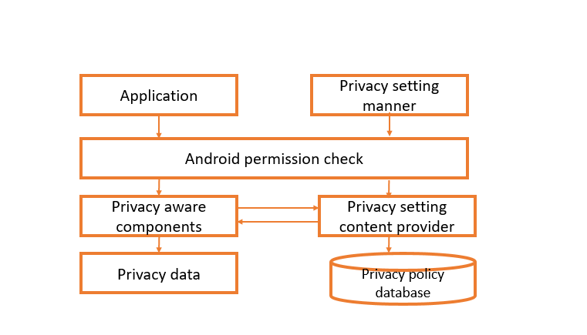
PROJECT PHASE 2 – VIVA VOCE
BLOCK DIAGRAM :

Slide 13
PROJECT PHASE 2 – VIVA VOCE
HARDWARE REQUIREMENTS :
System : Pentium i3 Processor.
Hard Disk : 500 GB.
Monitor : 15’’ LED
Input Devices : Keyboard, Mouse
Ram : 2 GB

Slide 14
PROJECT PHASE 2 – VIVA VOCE
SOFTWARE REQUIREMENTS :
Operating system : Windows 10.
Coding Language : Android, Java
Toolkit : Android 2.3 Above
IDE : Eclipse/Android Studio

Slide 15
PROJECT PHASE 2 – VIVA VOCE
LITERATURE REVIEW:
S.NO | TITLE | AUTHOR | TECHNIQUES | RESULTS | LIMITATIONS
1 | Analysis of Bayesian classification-based approaches for Android malware detection | Yerima, S. Y., Sezer, S., & McWilliams, G. (2014). | The Bayesian-based classifier consists of learning and detection stages. The learning stage uses a training set of known malicious samples in the wild and another set of benign Android applications, collectively called the app corpus. | Empirical results and comparative analysis are presented offering useful insight towards development of effective static-analytic Bayesian classification-based solutions for detecting unknown Android malware. | the limitations of traditional signature-based scanning as well as viable for filtering apps for further analysis by complementary methods or manual reverse engineering analysis by security analysts, thus reducing the costs and effort involved in uncovering new malware samples.
2 | Android Permissions: A Perspective Combining Risks and Benefits | Sarma, B. P., Li, N., Gates, C., Potharaju, R., Nita-Rotaru, C., & Molloy, I. (2012, June) | To achieve this, static analysis involves various binary forensic techniques, including decompilation, decryption, pattern matching and static system call analysis. | Analysis of Permission Based Risk signals. In order to get a baseline we first apply the only other mechanism that has been published to identify risk based on permissions, namely Kirin. | Android’s current permission warning approach has been very ineffective in curbing malicious applications. This is partly because the current mechanism of displaying permissions fails as an effective risk communication mechanism, as it warns the user about dangerous permission on almost all permissions.

Slide 16
PROJECT PHASE 2 – VIVA VOCE
LITERATURE REVIEW:
S.NO | TITLE | AUTHOR | TECHNIQUES | RESULTS | LIMITATIONS
3 | AppIntent: Analyzing Sensitive Data Transmission in Android for Privacy Leakage Detection | Yang, Z., Yang, M., Zhang, Y., Gu, G., Ning, P., & Wang, X. S. | we extract the minimal path (using the Dijistra’s algorithm) as a chain of events, which are sequentially triggered in the symbolic execution. | In this section, we present our evaluation results on the effectiveness and accuracy of AppIntent. In our evaluation, the event-space constraint guided symbolic execution uses an Intel Xeon machine with 2 eightcore 2.0Ghz CPUs and 32 GB physical memory, which runs Debian Linux with kernel version 2.6.32. The controlled execution of AppIntent is run on Android 2.3. | 1)First, native code is currently not supported by AppIntent. 2) Second, since the Android InstrumentationTestRunner does not support instrumentation of network input, our dynamic analysis platform cannot simulate network inputs generated by symbolic execution.
4 | Android platform-based individual privacy information protection system. | Zhang, W., Li, X., Xiong, N., & Vasilakos, A. V. (2016). | the Android platform-based individual privacy information protection system architecture and the key execution techniques; | the system could satisfy user functional and non-functional requirements, with stable operation and high task execution efficiency. | The disadvantage is inconvenience. This kind of protection measure may hinder the normal use of mobile phones and leak the user privacy information. 2) Its drawback is the same as screen locking, hindering the normal use of mobile phones .

Slide 17
PROJECT PHASE 2 – VIVA VOCE
LITERATURE REVIEW:
S.NO | TITLE | AUTHOR | TECHNIQUES | RESULTS | LIMITATIONS
5 | Android permissions demystified | Felt, A. P., Chin, E., Hanna, S., Song, D., & Wagner, D. (2011, October). | In this paper, we developed tools to detect overprivilege in Android applications. We applied automated testing techniques to Android 2.2 to determine the permissions required to invoke each API method. | Our results show that applications generally are overprivileged by only a few permissions, and many extra permissions can be attributed to developer confusion. This indicates that developers attempt to obtain least privilege for their applications but fall short due to API documentation errors and lack of developer understanding. | The Android API is too large to test all interdependent classes at once, so in practice many objects are not available in the sequence pool.
6 | Expectation and purpose: understanding users' mental models of mobile app privacy through crowdsourcing | Lin, J., Amini, S., Hong, J. I., Sadeh, N., Lindqvist, J., & Zhang, J. (2012, September). | We conclude with a discussion of implications for employing crowdsourcing as a privacy evaluation technique. | Our results suggest that our interface significantly increases users’ privacy awareness and is easier to comprehend than Android’s current permission interface. | 1) there could be an issue in the quality control of the work. 2) Outsourcing also creates dependency on another company for getting a job done.

Slide 18
PROJECT PHASE 2 – VIVA VOCE
MODULES
Threats to Android
Users and App Developers’ Mistakes
Malware Attacks on Android
Android Permission Check
Privacy Policy Database
Threats to Android
While Android has good built-in security measures, there are several design weaknesses and security flaws that have become threats to its users. Awareness
about those threats is also important to perform a proper malware detection and vulnerability analysis

Slide 19
Users and App Developers’ Mistakes
The mistakes can happen knowingly or unknowingly from the developers as well as users. These mistakes may lead to threats arising to Android OS and its applications. It has been identified that users are responsible for most security issues. Some common mistakes done by the users will lead to serious threats in an Android application. At the time of installing Android applications, users will be asked to allow some permissions.
Malware Attacks on Android
Malware attacks are the most common case that can be identified as a threat to Android. There are various definitions for malware given by many researchers depending on the harm they cause.

Slide 20
PROJECT PHASE 2 – VIVA VOCE
Android Permission Check
A user who wishes to install and use any third party app doesn’t understand the significance and meaning of the permissions requested by an application, and thereby simply grants all the permissions as a result of which harmful apps also get installed and perform their malicious activity behind the scene.
Privacy Policy Database
We presented a novel approach to the analysis of privacy policies in the context of Android applications. The tool we implemented greatly eases the process of understanding the privacy implications of installing third party apps and it has already been proven able to highlight worrisome instances of applications

Slide 21
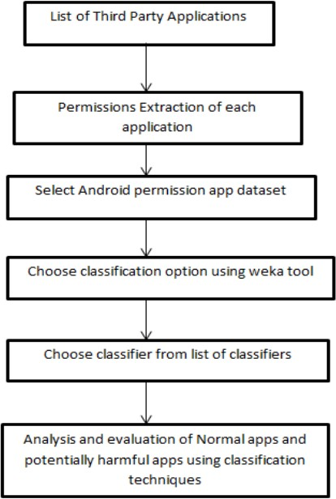
PROJECT PHASE 2 – VIVA VOCE
DATA FLOW DIAGRAM

Slide 22
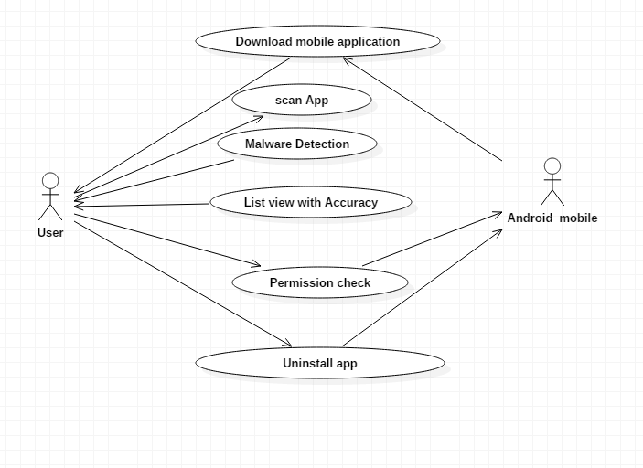
PROJECT PHASE 2 – VIVA VOCE
USE CASE DIAGRAM

Slide 23
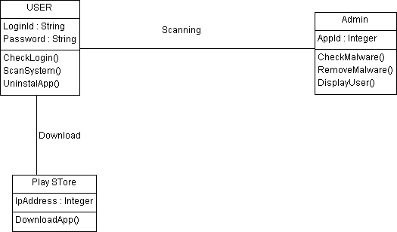
PROJECT PHASE 2 – VIVA VOCE
CLASS DIAGRAM

Slide 24
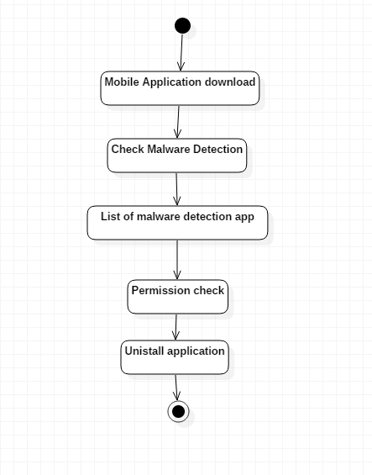
PROJECT PHASE 2 – VIVA VOCE
ACITIVITY DIAGRAM

Slide 25
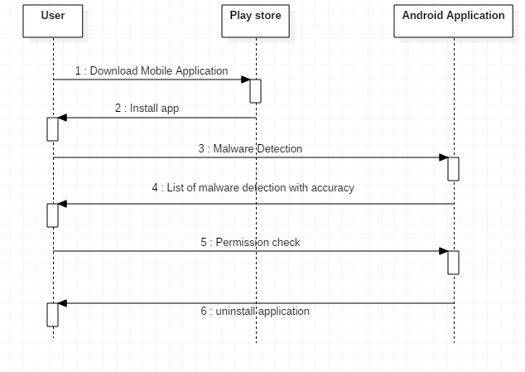
PROJECT PHASE 2 – VIVA VOCE
SEQUENCE DIAGRAM

Slide 26
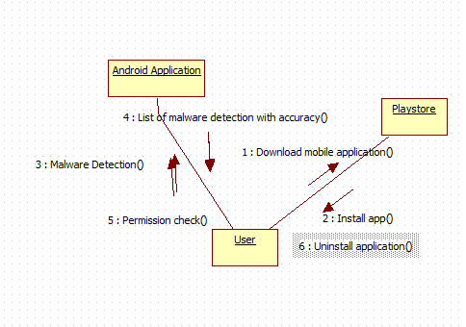
PROJECT PHASE 2 – VIVA VOCE
COLLABORATION DIAGRAM

Slide 27
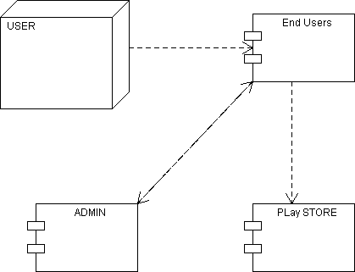
PROJECT PHASE 2 – VIVA VOCE
COMPONENT DIAGRAM

Slide 28
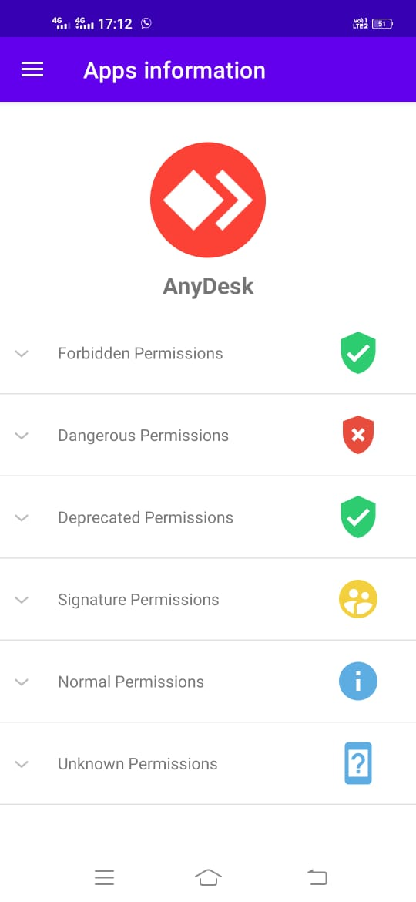
PROJECT PHASE 2 – VIVA VOCE
OUTPUT

Slide 29
PROJECT PHASE 2 – VIVA VOCE
REFERENCES :
[1] R. R. Subramanian, R. Ramar, “Design of Offline and Online Writer Inference Technique”, International Journal of Innovative Technology and Exploring Engineering, vol. 9, no. 2S2, Dec. 2019, ISSN: 2278-3075
[2] Subramanian R.R., Seshadri K. (2019) Design and Evaluation of a Hybrid Hierarchical Feature Tree Based Authorship Inference Technique. In: Kolhe M., Trivedi M., Tiwari S., Singh V. (eds) Advances in Data and Information Sciences. Lecture Notes in Networks and Systems, vol 39. Springer, Singapore

Slide 30
[3] Joshva Devadas T., Raja Subramanian R. (2020) Paradigms for Intelligent IOT Architecture. In: Peng SL., Pal S., Huang L. (eds) Principles of Internet of Things (IoT) Ecosystem: Insight Paradigm. Intelligent Systems Reference Library, vol 174. Springer, Cham
[4] R. R. Subramanian, B. R. Babu, K. Mamta and K. Manogna, "Design and Evaluation of a Hybrid Feature Descriptor based Handwritten Character Inference Technique," 2019 IEEE International Conference on Intelligent Techniques in Control, Optimization and Signal Processing (INCOS), Tamilnadu, India, 2019, pp. 1-5.

Slide 31
PRESENTATION : PHASE 2 – VIVA VOCE
THANK YOU

